Slide 1
How much has the Leeman Road area of York changed over time?
Lesson 1

Slide 2
Lesson 1: How can maps help us to define the Leeman Road area and identify changes?
Introduction to the enquiry
Who was George Leeman?
What do we mean by the ‘Leeman Road area’?
How do we identify the area on a map?
What are the differences and similarities between the current map and a historic map?
Can you place the maps in chronological order and explain your reasons?
Plenary

Slide 3
Learning objectives
To identify the features of the Leeman Road area
To sequence maps in chronological order

Slide 4
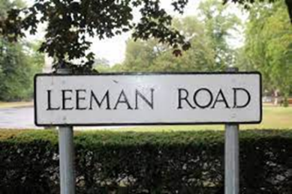
We are going to be looking at how the Leeman Road area of York has changed over time.
Why is it called Leeman Road?
Notes:
Image: Wikimedia Commons, https://commons.wikimedia.org/wiki/File:Plaque_Leeman_Road_York_1.jpg

Slide 5
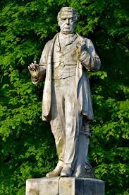
It is named after a man called George Leeman.
He was born in 1809. His father was a greengrocer, but he wanted to have a career and became a successful lawyer. He is remembered for his work with the railways.
Notes:
Image: R Bruce

Slide 6
George Leeman’s story is linked to another man, George Hudson.
In the 1830s, George Hudson was a very important man. He persuaded the engineer George Stephenson that the Newcastle-to-London railway should come through York rather than Leeds. Hudson became chairman of the York & North Midland Railway Company, with Stephenson as the engineer. By 1844, he controlled more than 1,000 miles of railway and was known as the Railway King.
But in 1848, cracks started to appear in his business. His arch rival, George Leeman, began an investigation that found that there was illegal share dealing. George Hudson fell into debt and was forced to travel to France to escape his creditors.
Following Hudson’s fall from grace, Leeman took over Hudson’s role as chairman of the York, Newcastle and Berwick railway.
The North Eastern Railway Company became one of the wealthiest railways in the country and had its headquarters in York. George Leeman was its chairman from 1874 to 1880.

Slide 7
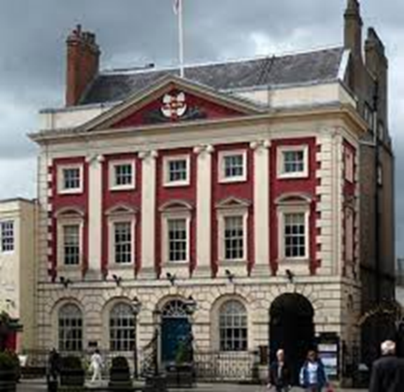
George Leeman became an important man. He was Lord Mayor three times and then was elected Member of Parliament from 1865 to 1868 and again from 1871 to 1880.
The Mansion House, official residence of the Lord Mayor of York
Notes:
Image: © Stephen Richards: https://www.geograph.org.uk/photo/4913901

Slide 8

I think that I am an important man and you should remember me because…
Notes:
Image: R Bruce

Slide 9
222 years ago
1840: First London-to-York train
122 years ago
22 years ago
Present day
1800
1900
2000
2022
1882: George Leeman died
1886: St Barnabas School founded
1809: George Leeman born
2005: St Barnabas new school built
1953: Queen Elizabeth crowned
1901: Queen Victoria died
1837: Queen Victoria came to the throne

Slide 10
Let’s think about the area now.​
What do we mean by the ‘Leeman Road area’?
What surrounds it? ​
What buildings are in the area?
What else is here? ​

Slide 11
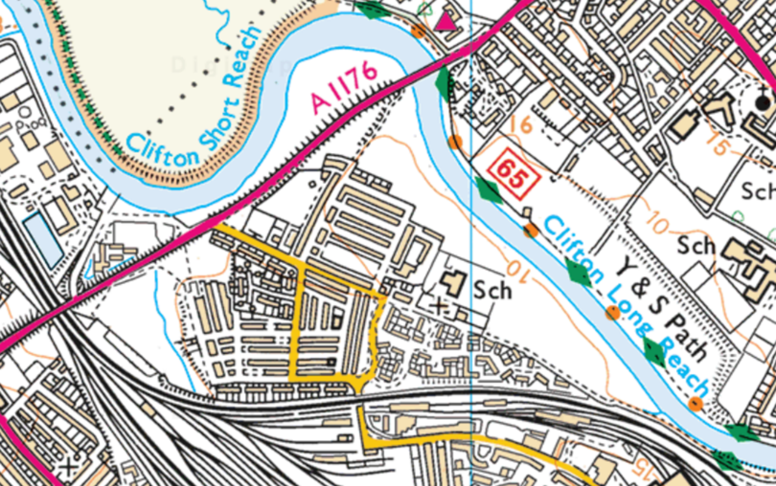
Can you see:
The river?
The railway line?
The school?
The church?
Notes:
Map: Ordnance Survey, www.ordnancesurvey.co.uk
Note: Railway and river. More houses, including some not in the grid pattern. Bridge crossing the river.

Slide 12
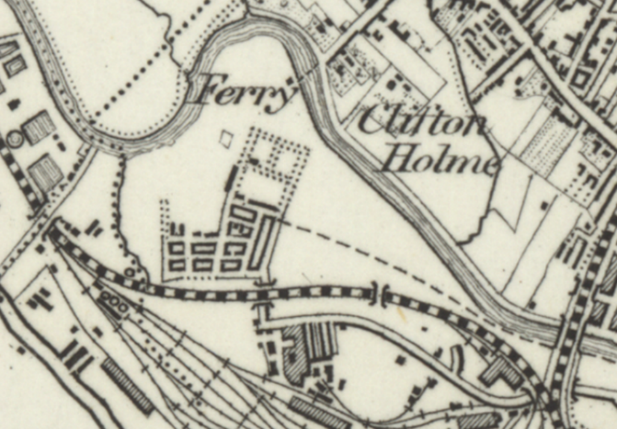
What do you notice about this map?
Does it show the same area?
How do you know?
Notes:
Map: National Library of Scotland, https://maps.nls.uk
1890s: Grid of streets has started to be built. Railway and river. Ferry to cross the river.

Slide 13
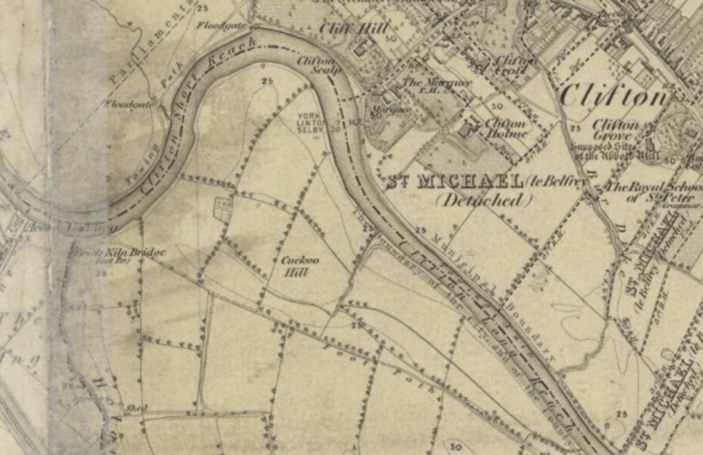
Is this map of the same area?
How do you know?
What features do you recognise?
When do you think it was made?
Notes:
Map: National Library of Scotland, https://maps.nls.uk
1850s: River recognisable but no railway line. Shape of field boundaries.

Slide 14
Chronological: Arranged in the order that they occurred, in time order

Slide 15
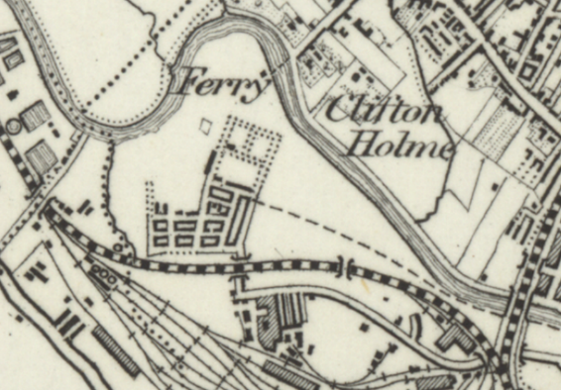
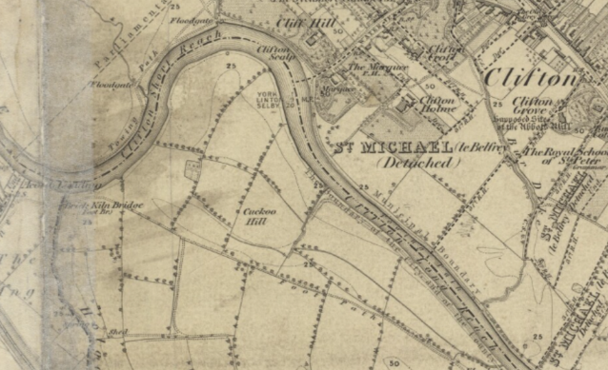
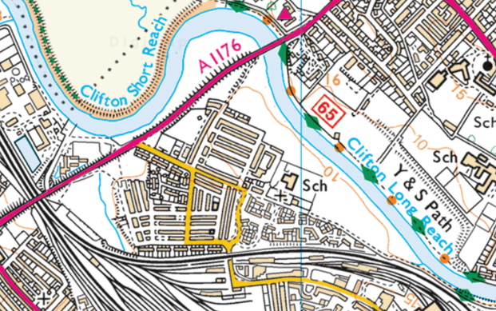
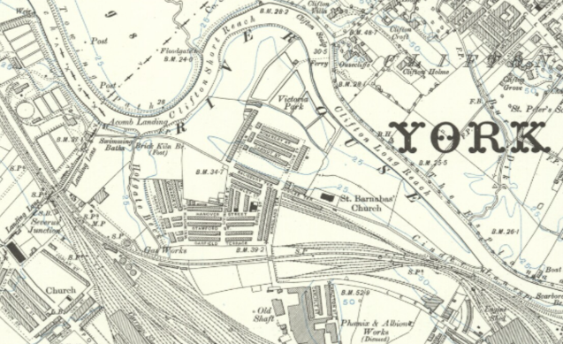
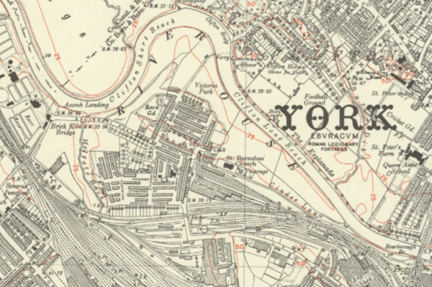
Can you place these maps in chronological order, from oldest to most recent?
How do you know what order to put them in?
Notes:
Maps: National Library of Scotland, https://maps.nls.uk
Previous maps plus maps from 1910s and 1950s. By 1950s, semi-detached houses built as well as terraces.

Slide 16
Plenary:
What order did you put the maps in?
How did you know which was the oldest?
What features are recognisable in all of the maps?
What has changed? What is still the same?

Slide 17
How much has the Leeman Road area of York changed over time?
Lesson 2

Slide 18
Lesson 2: What features of the Leeman Road area can we identify on a local walk?
Recap Lesson 1, defining the local area
What other features are there in the Leeman Road area?
Carry out a local walk
Plenary

Slide 19
Learning objective
To identify features of the local area through a local walk

Slide 20
Last week we looked at how the area has changed over time using maps.
We saw that the river is to the north, while the railway line is to the south.
What other features are there in the area?
Talk to your partner.
What buildings, parks, shops and other features can you think of?

Slide 21
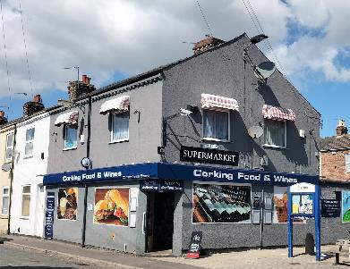
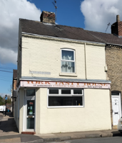
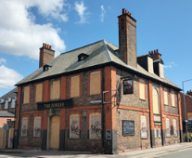
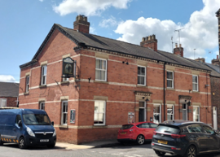
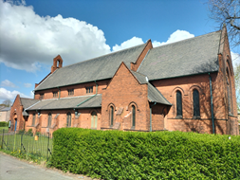
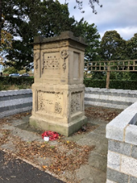
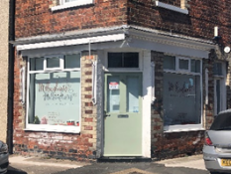
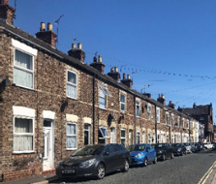
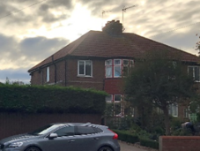
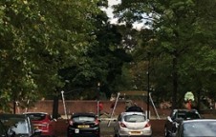
How many of these did you think of?
Notes:
Images: R Bruce
Top row: shop, Leeman pub, takeaway, church, Jubilee pub
Bottom row: hairdresser, park, semi-detached house, terraced house, war memorial

Slide 22
We are going to go for a walk around the area.
Look out for those features.
Can you spot any signs that buildings have changed use?
Think about the size of shop windows. Can you see any corner houses that still have bigger windows?
How many can you tick off on your Eye Spy sheet?

Slide 23
Plenary
What features did you spot?
Did you see any that weren’t on the list?
Were there any that you hadn’t seen before?
Did you notice any signs that buildings have changed use?
What differences do you think there would have been in the past?

Slide 24
How much has the Leeman Road area of York changed over time?
Lesson 3

Slide 25
Lesson 3: What can photographs tell us about continuity and change in the Leeman Road area?
Recall the features of the area seen on the walk
Look at a photograph of the local area and compare it to one of the same place in the past. What is the same? What is different?
Activity: Children compare pairs of photographs, note similarities and differences and record findings
Plenary

Slide 26
Learning objective
To use photographs of the local area to identify what has changed and what is the same

Slide 27
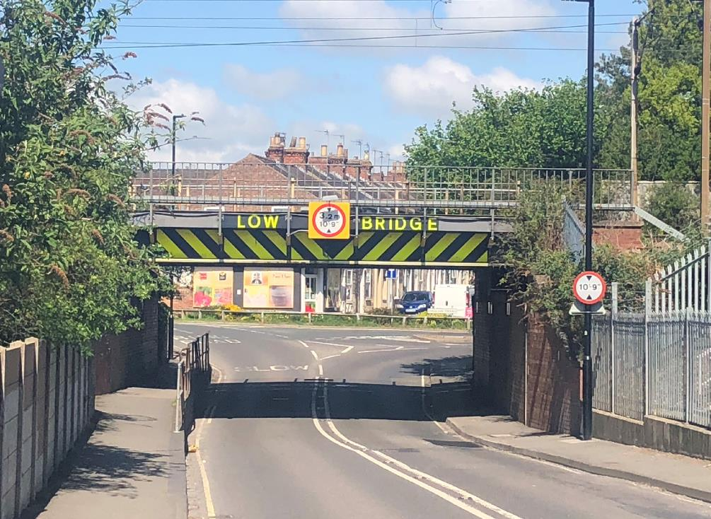
Where was this photograph taken?
What can we see in the picture?
Notes:
Image: R Bruce

Slide 28
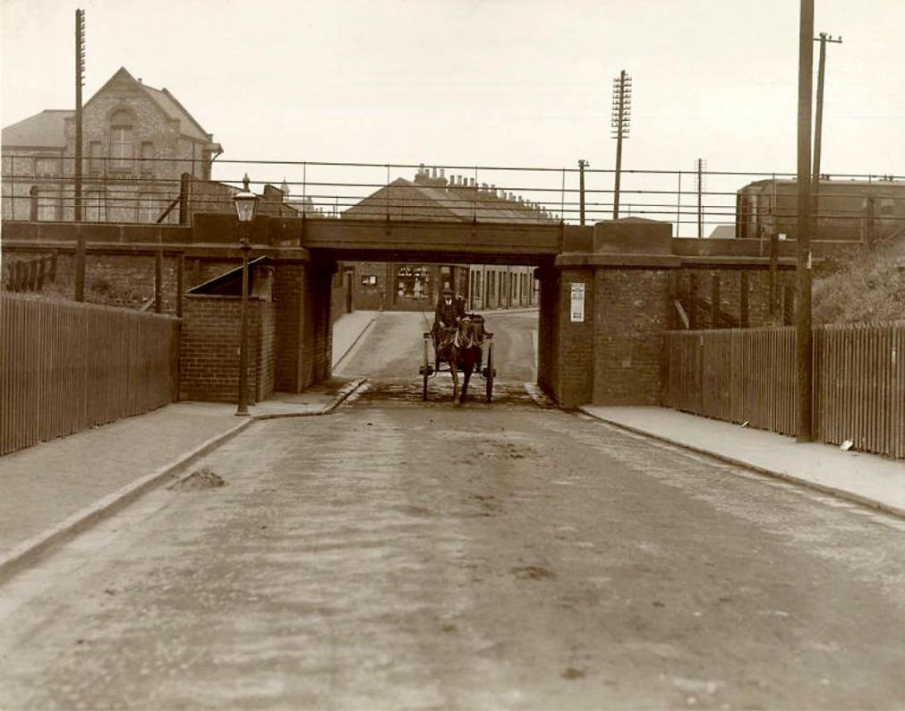
Is this photograph taken in the same place?
Do you think it was taken at the same time? Why?
Notes:
Image: © City of York Council / Explore York Libraries and Archives Mutual Ltd, Asset ID: 1002399, https://images.exploreyork.org.uk/default.aspx

Slide 29


Activity 1:
What is the same in these pictures? What is different?
What does that tell us?
Notes:
Images: R Bruce; © City of York Council / Explore York Libraries and Archives Mutual Ltd, https://images.exploreyork.org.uk/default.aspx

Slide 30
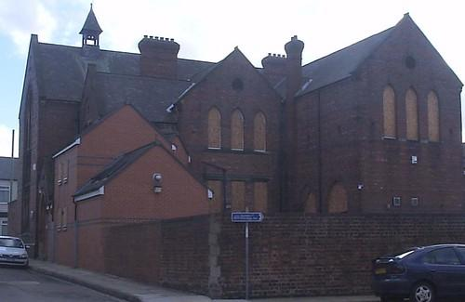
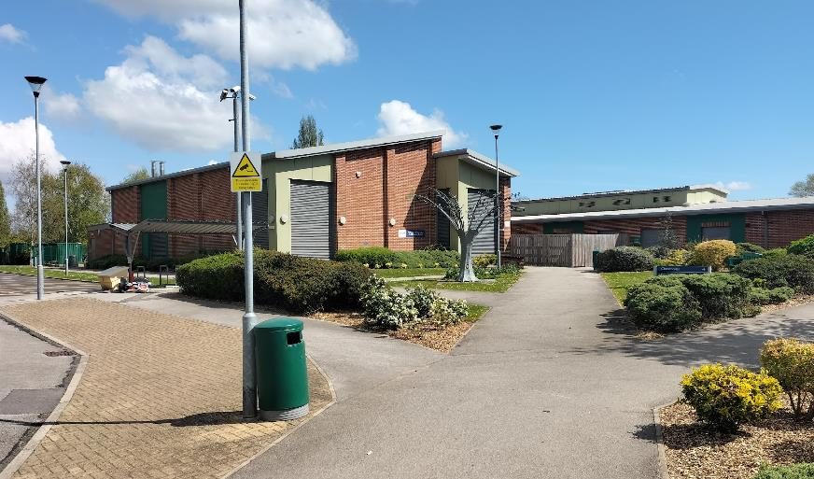
What is the same in these pictures? What is different?
What does that tell us?
Notes:
Images: R Bruce

Slide 31
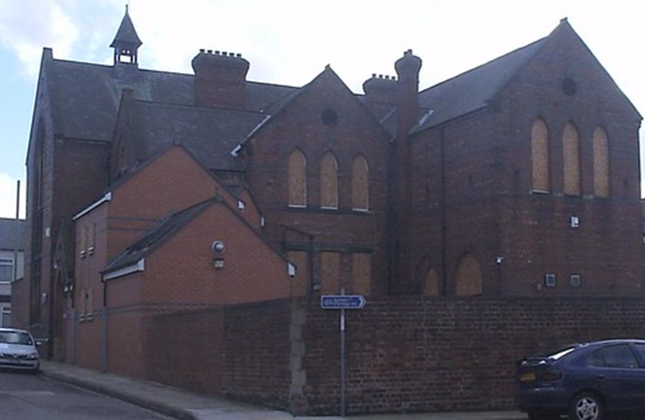
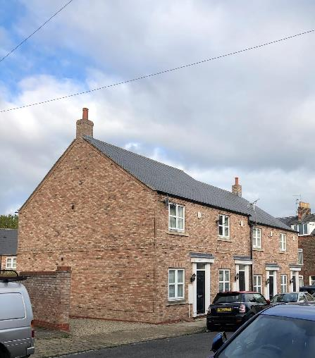
What is the link between these pictures?
Notes:
Images: R Bruce
The new houses are built on the site of the old school.

Slide 32
Activity 2:
Look at the pairs of photographs you have been given.
What is the same in the pictures?
What differences can you see?
What do they tell us about how much Leeman Road has changed?

Slide 33
Plenary
What differences have you noticed between the photographs of the Leeman Road area in the past and now?
Did anything surprise you?
What similarities were there?
Do you think that the Leeman Road area has changed much over time?

Slide 34
How much has the Leeman Road area of York changed over time?
Lesson 4

Slide 35
Lesson 4: How have shops in the Leeman Road area changed? What does that tell us about changing shopping habits?
Consider what shops there are in the area now, what they sell and where families do their shopping
Look at the evidence of shops in the Leeman Road area in the past
Activity 1: What was sold in shops? Look at adverts
Activity 2: Create a map of the shops in the 1920s
Plenary

Slide 36
Learning objectives
To look at evidence of shops in the past
To identify what has changed and consider why changes in shopping have occurred

Slide 37
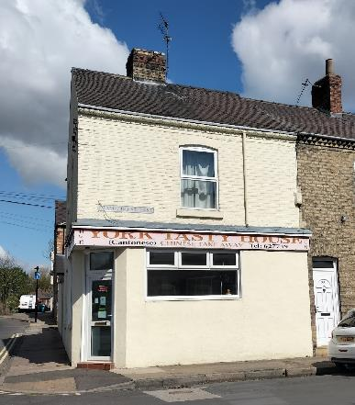
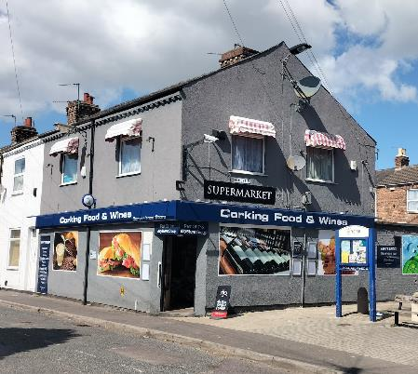
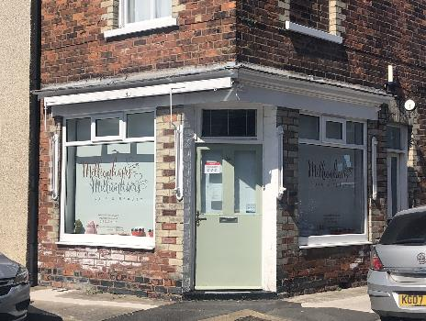
What shops are there in the Leeman Road area?
What do you buy from them?
Where do you do most of your shopping?
What differences do you think that there would have been in shops in the past?
Notes:
Images: R Bruce

Slide 38
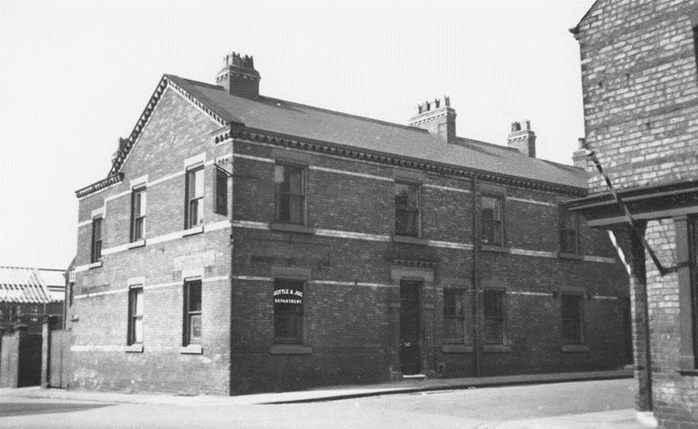
How do we know what shops were like in the past?
There are clues in photographs.
Can you see the poles outside the building on the right?
They show that it was a barber’s shop.
A barber cut men’s hair.
Notes:
Image: © City of York Council / Explore York Libraries and Archives Mutual Ltd, https://images.exploreyork.org.uk/default.aspx

Slide 39
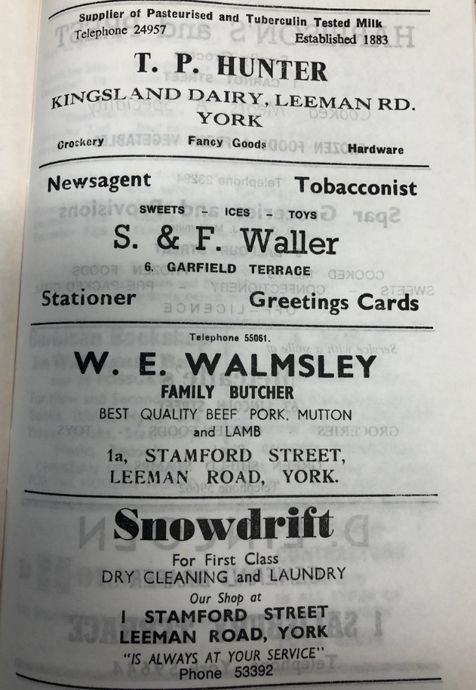
Here we have adverts from the parish magazine.
What shops are there?
What does a dairy sell?
What is a newsagent?
What can you buy in a butcher?
What would you do in a laundry?
What do you think fancy goods are?
Notes:
Image: PR/Y/BAR/62 Parish records of York, St Barnabas. Church magazines, 1956-1983. Images reproduced courtesy of the Borthwick Institute for Archives, University of York, www.york.ac.uk/borthwick

Slide 40
Did you know that:
A dairy sells milk, butter, eggs and cheese?
A newsagent sells newspapers and magazines?
A butcher sells meat, sausages and cooked meats?
A laundry washes your clothes, bedlinen and towels?
Fancy goods are items that are ornamental or decorative, rather than essential?

Slide 41
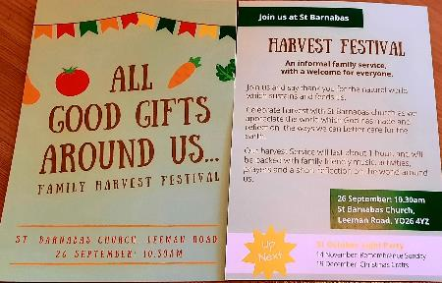
Vocabulary
Advert: An advert tries to persuade people to buy something or use a service.
Parish magazine: A parish is the community belonging to a church. They used to produce magazines to share useful information and tell people about events, and included interesting articles. Local businesses could pay to advertise in them. There are not so many parish magazines now, as they are expensive to publish, and more information is shared through social media or leaflets.
Notes:
Image: St Barnabas Church, York

Slide 42
Activity 1:
Look at the adverts from the parish magazines.
Can you work out what type of shops they are and what they sold?
Write your answers around the adverts.

Slide 43
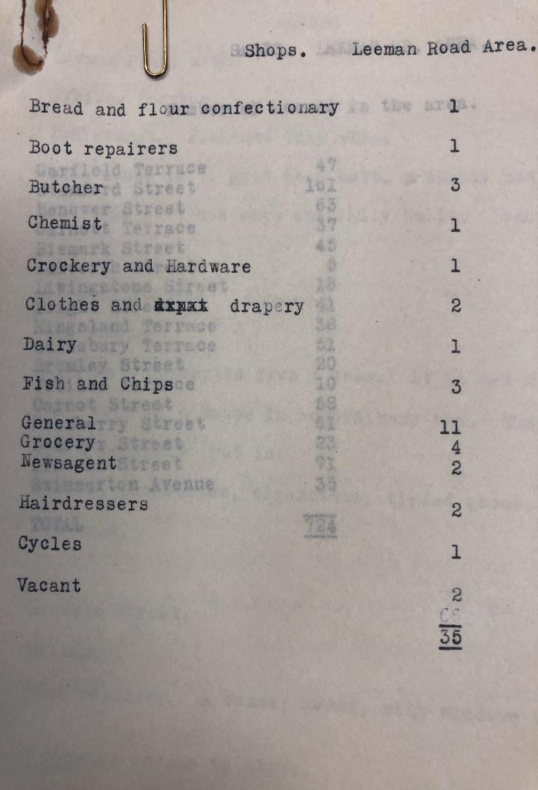
Activity 2:
In the 1920s, a survey was carried out, looking at the houses and shops in the local area.
A survey is when someone wants to find out information about a particular place or group – for example, how many shops or churches there are, what books people read or how many people live in an area.
What do you notice about the number of shops there were compared to now?
Notes:
Image: RFAM/BSR/UOY/21/28 Rowntree Family Papers, papers of Benjamin Seebohm Rowntree. Papers concerning the analysis of shops and numbers of customers across York, including descriptions of general shops in the Leeman Road area. Images reproduced courtesy of the Borthwick Institute for Archives, University of York, www.york.ac.uk/borthwick

Slide 44
Activity 2:
The survey included information about where the shops were and what they sold.
We are going to create a map to show the information that we have found out.

Slide 45
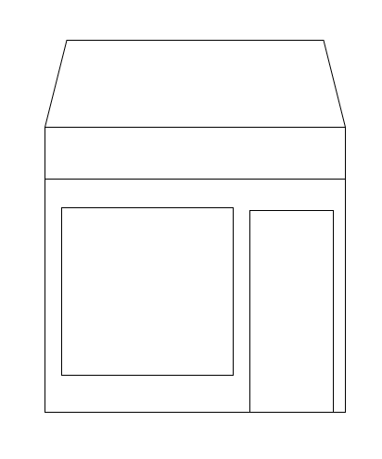
Activity 2:
You will be given information about a shop.
Write the type of shop in the roof.
Then the address.
Draw what it sold in the window.

Slide 46
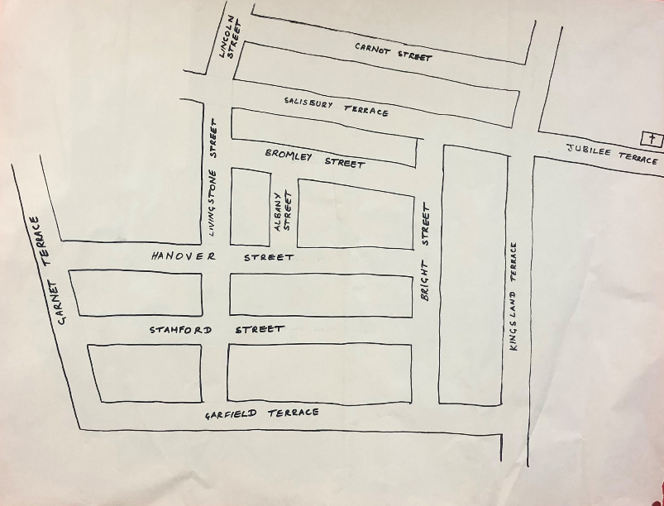
We will plot them on a map to show how many shops there were and what they sold, so we can compare them to shops today.
Notes:
Image: R Bruce

Slide 47
Plenary
What have we found out about shops in the Leeman Road area in the past?
Why do you think that there are fewer shops now?
Think about how we store food and get to the shops.

Slide 48
How much has the Leeman Road area of York changed over time?
Lesson 5

Slide 49
Lesson 5: How has the area changed during living memory?
What do we mean by living memory?
Activity 1: What would you ask someone who lived here in the past?
Activity 2: Interviews
Activity 3: What do people remember about the area?
What can we learn from people’s memories of the Leeman Road area?
Plenary

Slide 50
Learning objective
To use interviews to find out how the local area has changed during living memory

Slide 51
Living memory is within the last 80 to 100 years
2015
1920
1940
1960
1980
2000
2022
Your great grandparents were born
Your parents were born
Your grandparents were born
You were born

Slide 52
Activity 1:
What questions would you ask someone who lived in the area in the past?
Write your questions on a sticky note.

Slide 53
Activity 2:
Interview some people who lived in the area in the past or who have lived here for a few years.
Use your questions to find out what it was like living here.
Do you notice any similarities or differences between people’s memories?
Why might they be different?
Did they grow up here?
When did they live here?

Slide 54
Activity 3:
Read through the memories.
Did they go to St Barnabas school?
What were the houses in the Leeman Road area like in the past?
Did they have bathrooms?
What shops do they remember? How have they changed?
Record what you have learned in a speech bubble.

Slide 55
Plenary
What have we learned about how the Leeman Road area has changed during living memory?
Did anything surprise you?

Slide 56
How much has the Leeman Road of York changed over time?
Lesson 6

Slide 57
Lesson 6: How much has the Leeman Road area changed over time and are there aspects that have stayed the same?
Review the aspects of life in Leeman Road that we have looked at
What did the maps show about the development of the area?
What did the photographs show about how the area has changed and what has stayed the same?
How have the shops in the area changed?
What memories did people have about how the area has changed?
Record what the Leeman Road area was like in the past, what the area is like now and what is still the same in a class Venn diagram or a double bubble diagram
Plenary

Slide 58
Learning objectives
To review how much the Leeman Road area has changed over time
To identify features that have stayed the same
To identify reasons for changes

Slide 59

Maps
What did the maps show us about how the area has changed?
Notes:
Maps: (left and centre) National Library of Scotland, https://maps.nls.uk; (right) Ordnance Survey, www.ordnancesurvey.co.uk

Slide 60
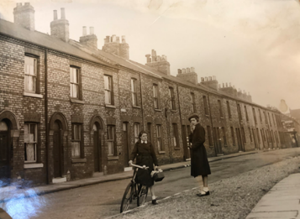
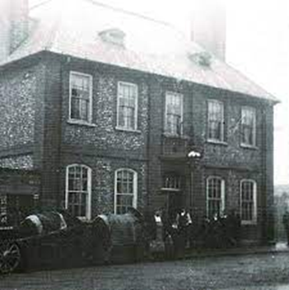
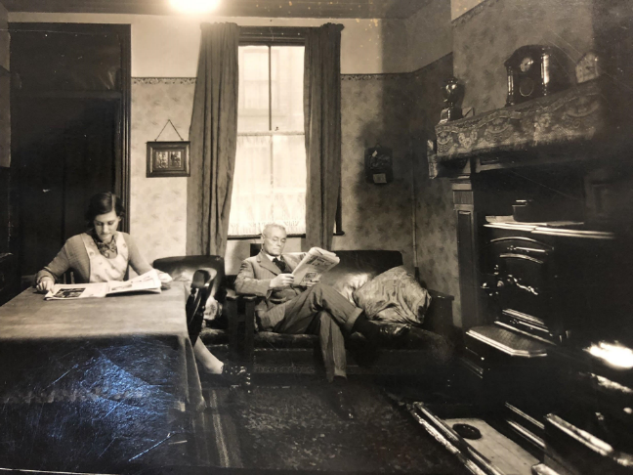
Photographs
What did the photographs tell us about how the area has changed?
Notes:
Images: (left and centre) RFAM/BSR/UOY/13/24 Rowntree Family Papers, papers of Benjamin Seebohm Rowntree. Poverty Survey Data: Photographs. Images reproduced courtesy of the Borthwick Institute for Archives, University of York, www.york.ac.uk/borthwick; (right) © City of York Council / Explore York Libraries and Archives Mutual Ltd, https://images.exploreyork.org.uk/default.aspx

Slide 61
Shops
How have shops changed over time?
Notes:
Image: https://images.exploreyork.org.uk/default.aspx

Slide 62
Memories
What changes did people tell us about in their memories of the Leeman Road area?

Slide 63
How much has the Leeman Road area changed over time?
What is Leeman Road like now?
What was Leeman Road like in the past?
What is the same?

Slide 64
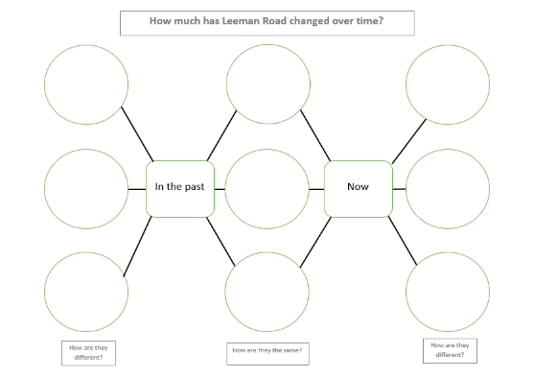
Double bubble diagram
A double bubble diagram is another way of showing continuity and change.
The bubbles on the left are used to show how the area was different in the past.
The bubbles on the right show how the area is different now.
The bubbles in the middle show continuity – what is still the same?

Slide 65
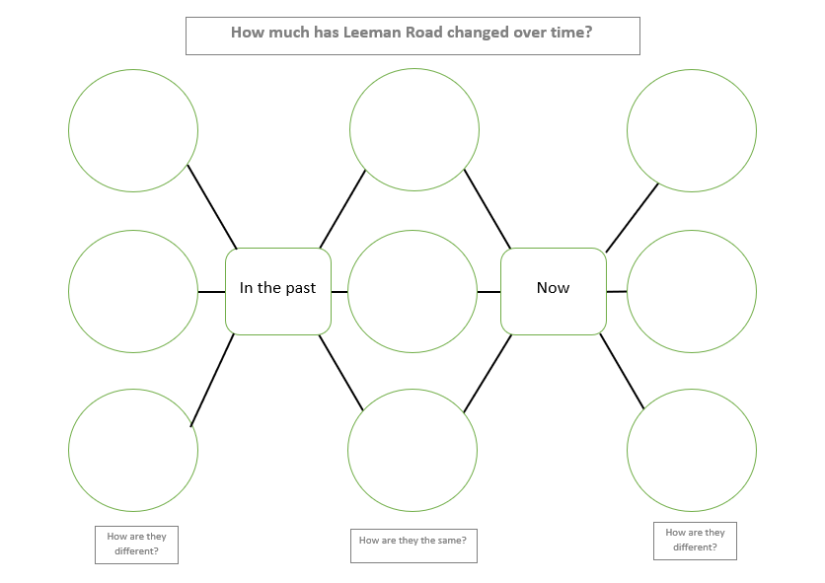

Slide 66
Plenary
What do you think the biggest change in the Leeman Road area has been?
Why do you think that this has been the biggest change?
I think... is the biggest change because...

